Slide 1
Upgrading from SharePoint 2007
Notes:
This module focuses on what is required to upgrade SharePoint 2007 farms to SharePoint 2010. You will learn the difference between an in-place upgrade and database attach upgrade as well as the technique for running a hybrid approach. The module also introduces the concepts and mechanisms involved with the Visual Upgrade feature which allows users to begin accessing a SharePoint 2010 site using the older SharePoint 2007 user interface and then to migrate the new SharePoint 2010 user interface.

Slide 2
Agenda
SharePoint 2007 Upgrade Overview
In-Place Upgrade
Database Attach Upgrade
Using a Hybrid Upgrade Approach
Understanding Visual Upgrade
Other Upgrade Considerations

Slide 3
Upgrade Methods
In-place Upgrade
Next > Next > Finished
Now restartable
Fewer break points, like timeouts
Database Attach
Content databases
Project database
Profile service database
Conspicuously absent…Gradual upgrade
Notes:
There are two primary approaches for upgrading SharePoint content.
In-place Upgrade
Database Attach
You can also use a hybrid of these two approaches to minimize downtime.

Slide 4
Agenda
SharePoint 2007 Upgrade Overview
In-Place Upgrade
Database Attach Upgrade
Using a Hybrid Upgrade Approach
Understanding Visual Upgrade
Other Upgrade Considerations

Slide 5
In-place Upgrade
Same hardware
SharePoint 2007 must be 64 bit
Same URLs
SharePoint 2007 is overwritten completely
Entire farm is down for the duration of the upgrade
Notes:
These are the steps:
After performing all pre-upgrade steps, the server administrator installs Microsoft SharePoint Server 2010 to the server running Microsoft Office SharePoint Server 2007 and chooses In-place Upgrade.
The upgrade process runs and upgrades the configuration database and the Central Administration site.
The upgrade process runs and upgrades any data specific to the server (for example, search settings).
The upgrade process runs on each virtual server and upgrades each site collection in that virtual server.
After all sites have been upgraded, the upgrade process ends.
Repeat the upgrade action on each server in a server farm environment.
The administrator confirms that upgrade is complete.

Slide 6
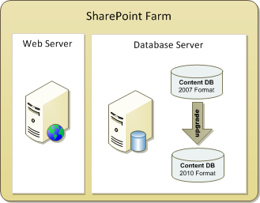
In-Place Upgrade Process
In-place upgrade is simplest approach
New SharePoint 2010 software installed
2007 SharePoint Databases Updated to 2010 format
Notes:
In-Place Upgrade Process
In place upgrade is the simplest upgrade type from an operational perspective. SharePoint in place upgrades are a good solution when the amount of content is small, and there are little or no server side customizations in the environment. They are not as good a solution when there are complex customizations in the environment, or if there is large amounts of content to upgrade and the downtime window cannot be very large. In-place upgrade can be used for either build to build or version to version upgrades.
A SharePoint in-place upgrade follows these high level steps:
New SharePoint version code is installed on the server and the configuration database is upgraded.
Each web application and content database is then upgraded.
Notes:
Any failures can potentially leave an in place upgrade in an unusable state.
The environment is unavailable throughout the upgrade.
Like how the content_dbs are upgraded, the v3 config_db schema is updated and continues to be used as the config_db

Slide 7
What about SSPs from SharePoint 2007?
SSP = Shared Service Provider
SSP provides 2007 User Profile Service
SSP provides 2007 User Search Service applications
Issues with SSP during upgrade
SSP Admin site not upgraded
Multiple SSPs are wired to appropriate web apps
Must upgrade parent of parent/child SSPs first
Notes:
Profile Service will need special consideration here as the method of import has changed dramatically. We now use the ForeFront Identity Manager to act as the proxy for imports (and writebacks to DC). Additional configuration steps need to be taken on the Domain Controller to allow profile import service account access.

Slide 8
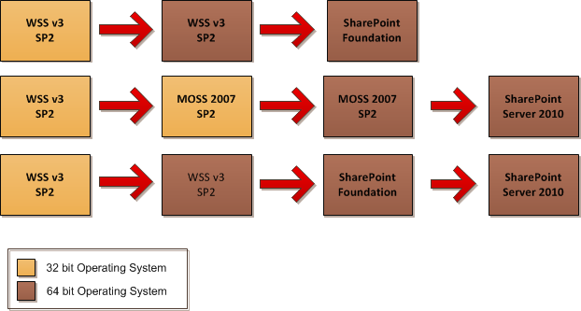
What if your SharePoint 2007 farm is x86?

Slide 9
In-place Pros/Cons
Pros
Settings are preserved
Customizations are preserved
Same URL, same hardware
Can use SharePoint 2007 search index until first crawl is run
Cons
Entire farm is offline during upgrade
No control over upgrade process, it runs serially

Slide 10
Agenda
SharePoint 2007 Upgrade Overview
In-Place Upgrade
Database Attach Upgrade
Using a Hybrid Upgrade Approach
Understanding Visual Upgrade
Other Upgrade Considerations

Slide 11
Database Attach
Databases that can be attached
Content DB
Project Server DB
Profile (SSP) DB
Databases that cannot be attached
Config DB
Search property store
Notes:
Content DBs must be SharePoint 2007 SP2 or later
If the SSP database is attached it is brought into the people service
Project Server 2007 did not support customizations, so those databases attach easily
Unlike SharePoint 2007 multiple databases can be attached to a farm at a single time.
You can attach multiple databases can be attached to the same server
The limitation is SQL I/O.
Good place to start is two databases per SQL instance

Slide 12
Database Attach Pros/Cons
Pros
Can upgrade multiple database simultaneously
Can choose the order databases are upgrade
Can combine databases from multiple farms
Cons
Lose customizations
Lose farm settings
Network and time intense
Need access to database server

Slide 13
Agenda
SharePoint 2007 Upgrade Overview
In-Place Upgrade
Database Attach Upgrade
Using a Hybrid Upgrade Approach
Understanding Visual Upgrade
Other Upgrade Considerations

Slide 14
Upgrade Strategies: Hybrid Approach
Combination of In-place and database attach
Detach all content databases
Do in-place upgrade to SharePoint 2010
Database attach upgrade content databases
Notes:
Hybrid approach offers best of both worlds
In-placeupgrade lets you keep settings, customizations, and URL.
With no databases the upgrade goes very quickly.
Also allows a very quick restore if things go wrong.
After update is complete, database attach method allows you to determine which databases are upgraded in which order. Database attach method allows you to upgrade database simultaneously which can significantly reduce overall time for upgrade to complete.

Slide 15
Upgrade Strategies: Downtime Mitigation
Read-only databases (2007 SP2, 2010)
Parallel database upgrade
Single farm, multiple databases
Multiple farms
Database attach with AAM redirect
Notes:
Set up AAM redirection with STSADM –o addzoneurl

Slide 16
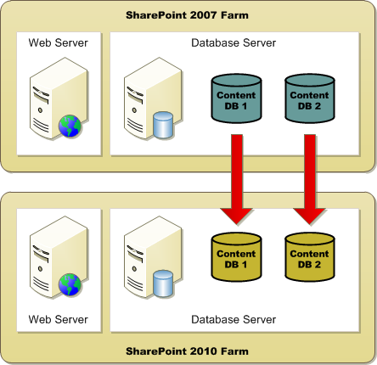
Database Attach with AAM Redirect

Slide 17
Agenda
SharePoint 2007 Upgrade Overview
In-Place Upgrade
Database Attach Upgrade
Using a Hybrid Upgrade Approach
Understanding Visual Upgrade
Other Upgrade Considerations

Slide 18
Visual Upgrade
Allows upgraded content to be rendered in SharePoint 2007 mode
Separates data upgrade from UI upgrade
Scoped at the web level
Site collection owner decides
Allows quicker upgrade
Can switch back and forth between SharePoint 2007 and SharePoint 2010 viewing.
Notes:
Visual Upgrade allows you to upgrade SharePoint 2007 farms and content to SharePoint 2010 before end users and power users are completely trained on SharePoint 2010. The idea is user continue to use the old user interface until they are ready to transition. The transition to move to the new user interface can be made at the site level or at the site collection level.
SharePoint 2010 ships with SharePoint 2007 master pages and CSS. The default.master file which ships with SharePoint 2010 contains the HTML with the 2007 User Interface. The new master page file containing the HTML with the new standard 2010 User Interface is named v4.master.
Some SharePoint 2007 site and components aren’t compatible:
MySites
PWA sites
Excel services web parts
Report Server web parts.

Slide 19
Visual Upgrade
Default upgrade UI is 2007
Option to use v4 UI in PSConfig
Single-click installations have no option
Granularity
Web UI
Site UI
Setup, PSConfig, and PowerShell, & stsadm
Reporting
Admins can report per Site Collection
Notes:
A PowerShell script could be written to enumerate through all the sites within a specific scope and to update each site to use the new 2010 interface. The scope could be that of a site collection, Web application or the farm.

Slide 20
Visual Upgrade Exceptions
My Sites
Public view customizations are not preserved on upgrade
Search Center
UI is reset, but web parts are preserved
Project Web Access
Did not support customizations in PWS 2007

Slide 21
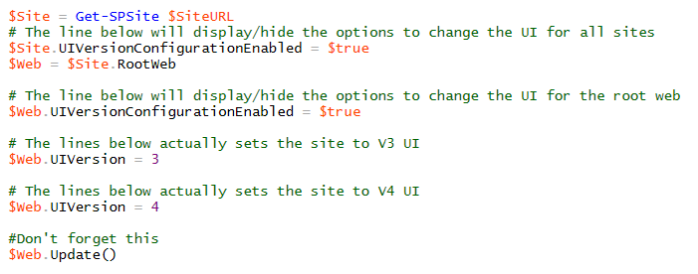
Visual Upgrade PowerShell
$Site = Get-SPSite $SiteURL
# The line below will display/hide the options to change the UI for all sites
$Site.UIVersionConfigurationEnabled = $true
$Web = $Site.RootWeb
# The line below will display/hide the options to change the UI for the root web
$Web.UIVersionConfigurationEnabled = $true
# The lines below actually sets the site to V3 UI
$Web.UIVersion = 3
# The lines below actually sets the site to V4 UI
$Web.UIVersion = 4
#Don't forget this
$Web.Update()
Notes:
Note that the slide above sets the UIVersion property to 3 and then sets it to 4. You will not do both. If you set the UIVersion property to 3 and call Update, you will put the site in 2007 UI mode. If you set the UIVersion property to 4 and call Update, you will put the site in 2010 UI mode.

Slide 22
Agenda
SharePoint 2007 Upgrade Overview
In-Place Upgrade
Database Attach Upgrade
Using a Hybrid Upgrade Approach
Understanding Visual Upgrade
Other Upgrade Considerations

Slide 23
Logging Upgrade Progress
Logging
One upgrade log per upgrade session
Saved in 14\Logs
Upgrade will not continue if log file cannot be created
Error only log
File with same name with –err
Logs only error information
Includes GUIDs, URLs and call stacks

Slide 24
Upgrade Reliability
Reliability has been improved
In-place upgrade can be resumed in case of failure
Upgrade process can be “sort of” successful
Removed, or made adjustable SQL timeouts
Notes:
Upgrade is smarter now, it won’t just stop if there is a problem. Unlike SharePoint 2007 if the in-place upgrade fails the problem can be fixed and the upgrade can be restarted.
Database attach upgrades can be “sort of” successful, some site collections can be upgraded even though others fail
SQL timeouts were the bane of SharePoint 2007 upgrades. Large content sources would often fail just because the operation took a long time. This is not the case with SharePoint 2010

Slide 25
Visual Feedback During Upgrade Process
Experience improved with Visual Feedback
Stsadm and PowerShell both report percentage completed on screen
Better warnings and error messages to help address issues
Sites near or at quota limits will be upgraded
Site Collections that are locked will be upgraded and relocked
Improved upgrade status page in Central Administration

Slide 26
Feature Upgrade
Feature upgrade
Features have an enforced version
The version is tracked in the database and per scope
A web, site, web app or farm will be determined as “needing upgrade” in Central Administration
Psconfig –upgrade will execute per-feature upgrade code
Feature version upgraded in database
Iisreset after deploying a new version of Feature definition
Notes:
Features will now have an enforced version semantic.
The version semantic will be tracked in the database and per scope. For example, for each web we will now track and be able to return what version of a feature the web thinks it’s at.
What actions need to be taken with sites using Feature Stapling on out of the box Site Definitions?
Example, At one customer we had to use Feature stapling to remove the OWA web parts from My Sites.
Answer: If there feature stays the same, then there is nothing for them to do.

Slide 27
Other Upgrade Concerns
Document versions stored differently
Will slow down upgrade if you have lots of versions due to change
Templates
STPs are not upgraded. You need to account for them in your planning
Branding
Masterpages are similar but must be redone
Themes are not upgradeable, all new

Slide 28
Summary
SharePoint 2007 Upgrade Overview
In-Place Upgrade
Database Attach Upgrade
Using a Hybrid Upgrade Approach
Understanding Visual Upgrade
Other Upgrade Considerations

